Slide 1
QUICKSORT

Slide 2
Roadmap: the Quicksort story
Understand the algorithm as a chain of ideas, not as isolated pseudocode.
1
Partition
3
Recursion
5
Randomize
Rearrange around
a pivot
Sort the two sides
Break dependence
on input order
2
Invariant
4
Recurrences
6
Expectation
Prove partition
correctness
Relate split quality to time
Count comparisons probabilistically
Central question
Why can a sorting algorithm with a Θ(n²) worst case still have Θ(n log n) expected time — and why does pivot choice explain the entire story?

Slide 3
Why Quicksort matters
A deceptively simple algorithm whose performance is controlled by partition quality.
Expected speed
In-place behavior
Worst-case warning
Expected running time is Θ(n log n), with small constant factors in practice.
The standard partitioning process rearranges elements within the input array instead of allocating a separate merge buffer.
With maximally unbalanced partitions, running time grows to Θ(n²). Sorted input triggers this for the fixed-last-element pivot rule.
The same algorithm can trace two radically different recursion trees:
n
n
n−1
≈ n/2
≈ n/2
n−2
balanced → logarithmic depth
unbalanced → linear depth

Slide 4
The divide-and-conquer anatomy of Quicksort
For a subarray A[p…r], partition determines the pivot’s final position q.
Before partition
pivot x = A[r]
A[p…r]
PARTITION
After partition
A[p…q−1] ≤ x
x
A[q+1…r] > x
p
q
r
Divide
Conquer
Combine
Create two subproblems around the pivot.
Recursively sort left and right sides.
No explicit merge step is needed.
CLRS 3e, §7.1, pp. 170–171

Slide 5
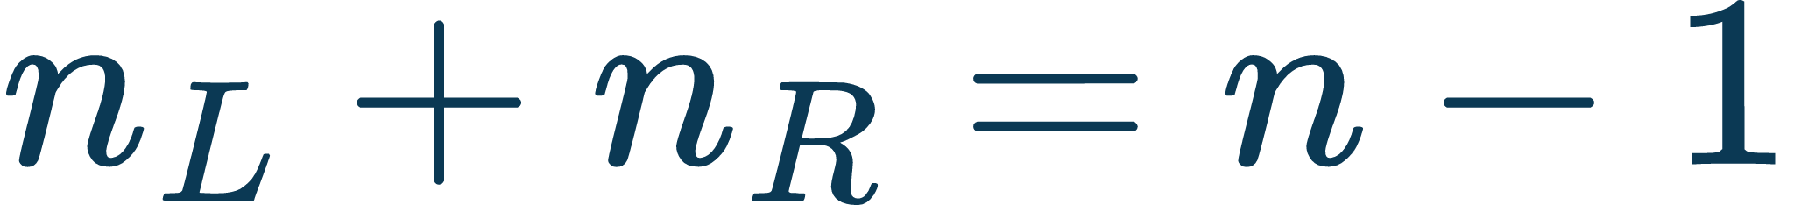
Recursive structure: what Quicksort actually does
The pivot is placed permanently; recursion never includes it again.
Equivalent pseudocode (rephrased from CLRS)
Subarray A[p…r]
QUICKSORT(A, p, r)
1. If p ≥ r, stop.
2. q ← PARTITION(A, p, r)
3. QUICKSORT(A, p, q−1)
4. QUICKSORT(A, q+1, r)
Partition → pivot at q
Left: A[p…q−1]
Right: A[q+1…r]
pivot excluded forever
Base case: a subarray of length 0 or 1 is already sorted.

Slide 6
PARTITION: the engine inside Quicksort
At every loop iteration, the array is divided into four logical regions.
p
i
j
r
≤ x
> x
unclassified
x
i marks the end of the “≤ pivot” region.
j scans left-to-right through the unclassified region.
When A[j] ≤ x: increment i, then swap A[i] and A[j].
When A[j] > x: only advance j.
Finally swap the pivot with A[i+1]; return q = i+1.
Key cost fact
For a subarray of length n, the scan tests n−1 non-pivot elements. Therefore PARTITION is Θ(n).
CLRS 3e, Fig. 7.2 and §7.1

Slide 7
Correctness of PARTITION via a loop invariant
The invariant is the proof mechanism that makes the diagram mathematically meaningful.
Invariant at the start of each scan step
1
Initialization
For pivot x = A[r]:
• A[p…i] ≤ x
• A[i+1…j−1] > x
• A[r] = x
• A[j…r−1] is not yet classified
i = p−1 and j = p. The two classified regions are empty, so the first two claims hold vacuously.
2
Maintenance
If A[j] > x, only j moves. If A[j] ≤ x, increment i and swap; both classified regions remain valid.
3
Termination
When j = r, every non-pivot item is classified. Swapping x with A[i+1] puts the pivot between the two regions.

Slide 8
Worked partition example: A = ⟨2, 8, 7, 1, 3, 5, 6, 4⟩
Pivot x = 4. Watch the boundary i move only when a value ≤ 4 is encountered.
Step 1
Step 2
Step 3
2
8
7
1
3
5
6
4
2
8
7
1
3
5
6
4
2
8
7
1
3
5
6
4
j
i
j
i
j
Start: no item classified
2 ≤ 4 → smaller region grows
8,7 > 4 → j advances
Step 4
Step 5
Step 6
2
1
7
8
3
5
6
4
2
1
3
8
7
5
6
4
2
1
3
4
7
5
6
8
i
j
i
j
i
j
1 ≤ 4 → swap with first “>4” item
3 ≤ 4 → swap into smaller region
Final pivot swap → q = 4th position

Slide 9
From one partition to the full sort
Each pivot locks into its final rank, splitting the remaining work.
[2, 8, 7, 1, 3, 5, 6, 4]
[2,1,3]
4 fixed
[7,5,6,8]
[2,1]
3 fixed
[5,6]
7 fixed
8 fixed
1 fixed
2 fixed
5 fixed
6 fixed
Final order:
1
2
3
4
5
6
7
8
Insight: recursion is not “moving the pivot later”; it permanently settles one rank at every partition.
Conceptual recursion tree; CLRS §7.1

Slide 10
Cost model: partitioning dominates the running time
Quicksort complexity is the sum of linear partition costs across the recursion tree.
Recursion-tree viewpoint
n
Why Θ(n)?
q
n−q−1
The loop examines each of the n−1 non-pivot elements once. Swaps are O(1). The final pivot swap is O(1). Hence total work grows linearly with subarray length.
Total subproblem sizes on a level ≈ n
Therefore, the number of “useful levels” is the decisive factor.

Slide 11
Worst case: every pivot is an extreme element
One side has size n−1 and the other has size 0 at every recursive call.
n
n−1
n−2
When can this happen?
With the fixed-last-element pivot rule, already sorted or reverse-sorted distinct input produces an extreme pivot at every step.
⋮
1
recursion depth ≈ n
Θ(n²) comparisons

Slide 12
Best case: nearly equal halves at every split
Balanced partitioning minimizes recursion depth.
Each level performs Θ(n) total partition work.
n
n/2
n/2
n/4
n/4
n/4
n/4
n/8
n/8
n/8
n/8
n/8
n/8
n/8
n/8

Slide 13
A surprising result: 9:1 splits are still O(n log n)
Quicksort does not require perfect halves; any fixed proportional split keeps logarithmic depth.
n
Why the total is still O(n log n)
0.1n
0.9n
At each active level, subproblem sizes sum to at most n, so the level costs O(n). The deepest branch is logarithmic because repeated multiplication by 0.9 reaches 1 after Θ(log n) steps.
0.09n
0.81n
0.729n
deepest branch ≈ log₁₀⁄₉ n
even 99:1 → O(n log n)

Slide 14
Average-case intuition: “bad” splits can be absorbed
A bad split followed by a good split can make the same progress as one balanced level, up to constants.
Two consecutive levels
Equivalent progress
n
n
0
n−1
≈n/2
≈n/2
≈(n−1)/2
≈(n−1)/2
cost = Θ(n)
cost ≈ n + (n−1) = Θ(n)
Core idea
Random inputs produce a mixture of good and bad partitions. A few bad levels only change constants; sufficiently frequent constant-fraction splits keep total expected work near n log n.

Slide 15
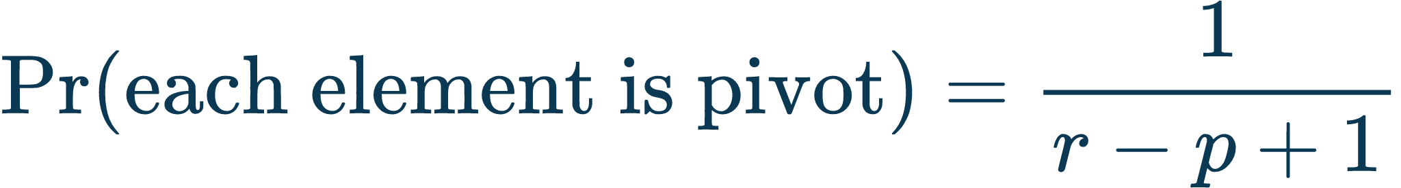
Randomized Quicksort: make pivot quality independent of input order
Instead of trusting the input distribution, inject randomness into pivot selection.
Subarray A[p…r]
Choose i uniformly in [p,r]
Swap A[i] ↔ A[r]
Run ordinary PARTITION
What randomization changes
What it does NOT change
No fixed input order can reliably force the same bad pivot pattern; the split distribution is controlled by the algorithm’s random choices.
Worst-case asymptotic time remains Θ(n²); the guarantee is on expected performance, not on an impossible elimination of bad random outcomes.

